Slide 1

Priority Queues
"Deadlines aren't bad. They help you organize your time. They help you set priorities. They make you get going when you might not feel like it. "
- Harvey B. Mackay
CLRS, Section 6.5

Slide 2
Priority Queue
Priority queue is a queue where elements are accessed according to their priorities.
Max-Priority Queue
Element with highest priority is served before element with lower priority.
Min-Priority Queue
Element with lowest priority is served before element with higher priority.
Heaps are usually used to implement priority queues.

Slide 3
Example: Min-Priority Queue
Each element has a key and a value.
(2, Sue)
(5, Pat)
(6, Mark)
(9, Jeff)
(7, Anna)
The keys used to build Min-Heap.

Slide 4
Priority Queues
Max-Priority Queue supports the following operations:
Maximum(A): Returns element with largest key.
Extract-Max(A): Removes / returns element with largest key.
Increase-Key(A,i,k): Increases key of element in position i to k.
Insert(A,x,k): Inserts element x with key k.
Similarly, a Min-Priority Queue supports Minimum, Extract-Min, Decrease-Key, and Insert operations.

Slide 5
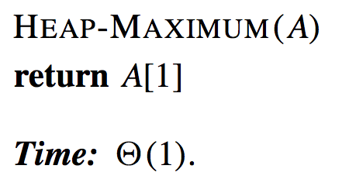
Max-Heap Implementation
Maximum(A):

Slide 6
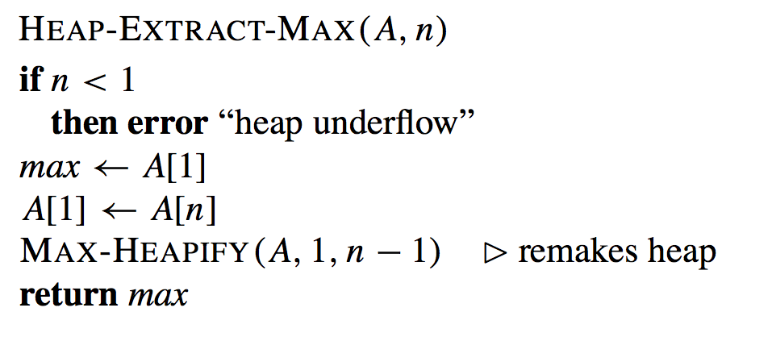

Max-Heap Implementation
Extract-Max(A):

Slide 7
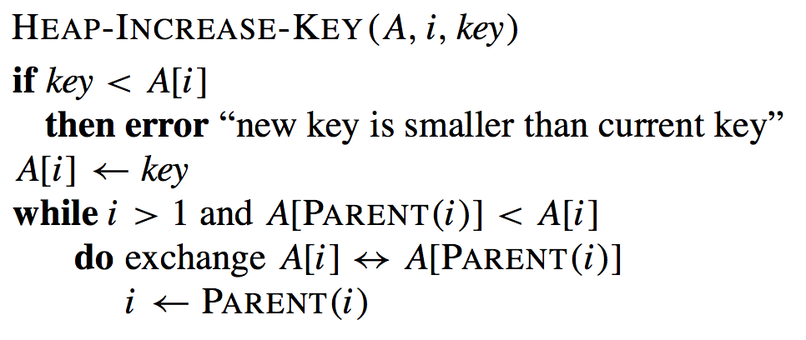
Max-Heap Implementation
Increase-Key(A,i,k):

Slide 8
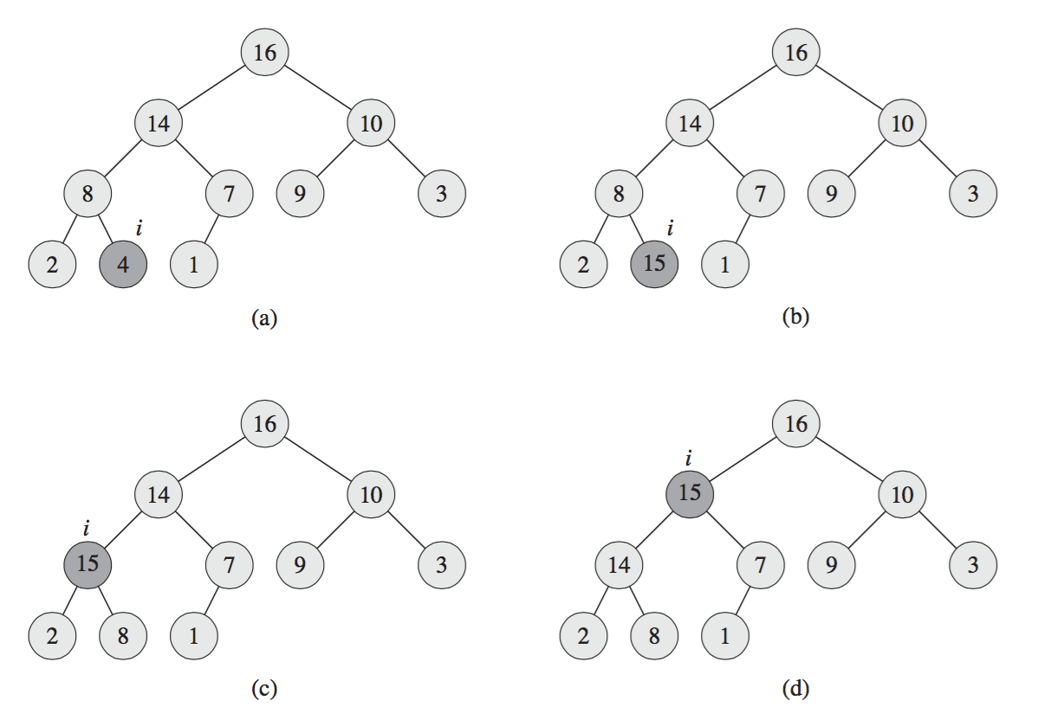
Example: Increase-Key
Increase-Key(A,9,15):
i = 9, key = 15
15 > 4, no error
1 | 2 | 3 | 4 | 5 | 6 | 7 | 8 | 9 | 10 | 11 | 12 | 13 | 14 | 15 | 16
16 | 14 | 10 | 8 | 7 | 9 | 3 | 2 | 4 | 1 | - | - | - | - | - | -

Slide 9
Example: Increase-Key
Increase-Key(A,9,15):
A[9] = 15
1 | 2 | 3 | 4 | 5 | 6 | 7 | 8 | 9 | 10 | 11 | 12 | 13 | 14 | 15 | 16
16 | 14 | 10 | 8 | 7 | 9 | 3 | 2 | 15 | 1 | - | - | - | - | - | -

Slide 10
Example: Increase-Key
Increase-Key(A,9,15):
A[4] < A[9]
swap A[9], A[4]
i = 4
1 | 2 | 3 | 4 | 5 | 6 | 7 | 8 | 9 | 10 | 11 | 12 | 13 | 14 | 15 | 16
16 | 14 | 10 | 15 | 7 | 9 | 3 | 2 | 8 | 1 | - | - | - | - | - | -

Slide 11
Example: Increase-Key
Increase-Key(A,9,15):
A[2] < A[4]
swap A[4], A[2]
i = 2
1 | 2 | 3 | 4 | 5 | 6 | 7 | 8 | 9 | 10 | 11 | 12 | 13 | 14 | 15 | 16
16 | 15 | 10 | 14 | 7 | 9 | 3 | 2 | 8 | 1 | - | - | - | - | - | -

Slide 12
Example: Increase-Key
Increase-Key(A,9,15):
A[1] > A[2]
while done
1 | 2 | 3 | 4 | 5 | 6 | 7 | 8 | 9 | 10 | 11 | 12 | 13 | 14 | 15 | 16
16 | 15 | 10 | 14 | 7 | 9 | 3 | 2 | 8 | 1 | - | - | - | - | - | -

Slide 13
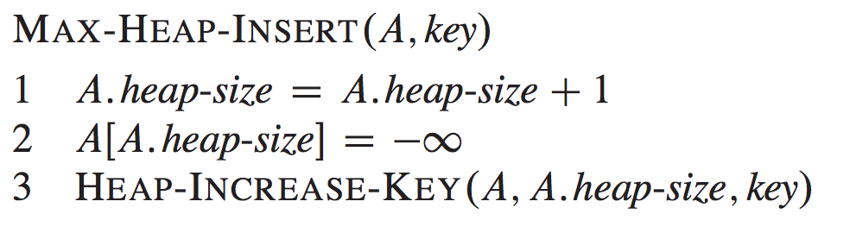
Max-Heap Implementation
Insert(A,x,k):

Slide 14
Priority Queue
In summary, a heap can support any priority-queue operations in O(log n) time.

Slide 15
Exercise 1
How to implement a standard queue (FIFO) with a priority queue?

Slide 16
Exercise 2
How to implement a stack (LIFO) with a priority queue?

